Slide 1
Behavioral Health Team
(11 RN’s,3 PEER’s & 1Counselor)

Slide 2
How do Patients get Referral to Behavioral Health
From RN staff (in-patient or ER )
From Physician/Provider (ER or In-patient )
System Generated by multiple triggers
Call in from community ( may see resource packet from BH dept) or word of mouth
Patients we see
Any with Mental Health diagnosis primary or secondary
Any SUD primary or secondary diagnosis or use

Slide 3
The Nurses assess, evaluate and round on Approximately 30-60 patients a day with Mental Health diagnosis and/ or Substance Use Disorder. Many of the nurses are credentialed mental health screeners but can also facilitate consultations with tele-psychiatry when necessary. We facilitate treatment in-patient and out-patient as needed. We respond to BERT (behavioral emergency response team) alerts and Code Lavenders (employee emotional distress). Kathy & Sarah help identify the best individualized path to recovery while supporting the individual and families during & after that process. They have become an integral part of the team.

Slide 4
In 2021 the Team engaged with 4,142 patients So far through the month of Sept 2022 the team has engaged with 5,256 patients.

Slide 5
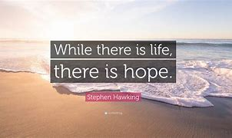

Slide 6
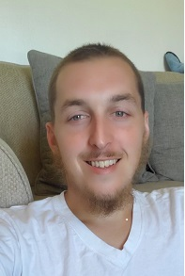
We have recently been able to add a 3rd Peer to our team and a Licensed Counselor.
We have recently hired a Counselor . This has enabled our patients to get immediate Counseling on the spot. This has helped to encourage therapy for those that may not otherwise engage in that treatment modality. She brings many years of experience. Sonya has hit the ground running and her knowledge and compassion is helping to make even more of a difference.
Dillon is our 3rd Peer Recovery Specialist and while still under orientation he has been able to engage with one of our SUD patients that we see but refuses our resources. One meet with Dillon and he engaged with Peer Support. Dillon has also teamed up with Sarah and has been able to build rapport with some of the dads of our SUD moms’.

Slide 7
We are a growing dept with a lot of vision. We are planning family and PEER group meetings(currently we do place patients on virtual AA/NA meetings while in the hospital), to meet with local schools to partner/attend community events and provide preventive education, to have Sarah meet with perinatal patients early in pregnancy and Beebe is expanding Behavioral Health and Substance Use Disorder Services to include a Mobile Unit and some outpatient services as well.
This Photo by Unknown Author is licensed under CC BY-NC-ND

Slide 8
When asked what we do everyday the first thought that usually comes to my mind is we fight. We fight stigma, we fight the broken parts of the system , we sometimes must fight authority, we fight providers, we fight ignorance, we fight rules , we fight the horrible disease that Is addiction. We fight for and with our patients, and we do it with all that we have, and we do it with a passion that we would do for a loved one or family member.

Slide 9
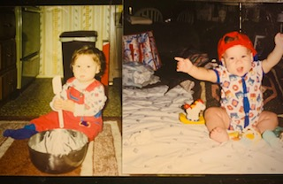
Elias
Gone too Soon

