Slide 1
Community Health Workers at ChristianaCare

Slide 2
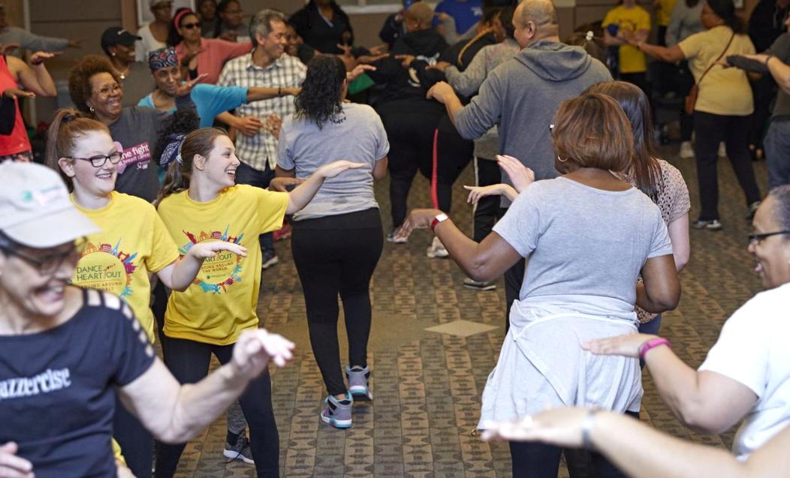
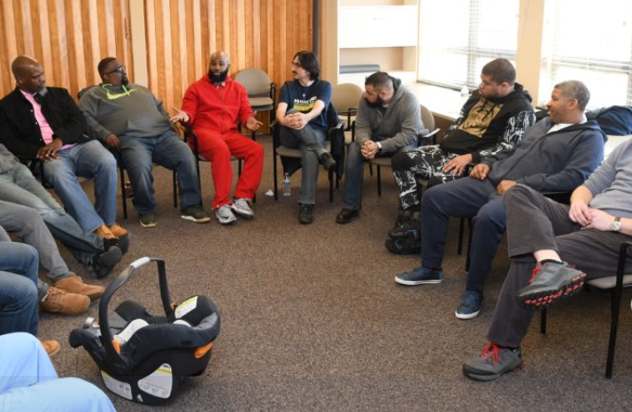
Background
Community Health has been serving Delaware with education and connection to resources for more than 20 years
ChristianaCare Community Health Worker program launched in 2019
Community Health Workers trained using UPENN IMPaCT model
Programming expansion to include episodic and longitudinal care

Slide 3
Community Health Workers
CHW Story from September 2020
Notes:
Carol Green-Archie, a community health worker at ChristianaCare

Slide 4
How CHWs Work with Patients
Care relationship focused on patient-centered goals
Set Goals
Support provided to patient to address barriers to meeting goals
Support
Connect patient to services for continued support
Connect

Slide 5
Clinical Collaborations
Community Health Workers embedded in the ED,
Primary Care, the School-Based Health Centers and
Women’s Health, connecting patients to resources, support.
Community SOS, a collaboration with internal and external partners to work with individuals suspected of SUD, post-discharge to connect them with treatment options, education.
EVOLV, a hospital-based violence prevention program provides wrap-around services and supports for individuals who are victims of penetrating wounds. This service continues post-discharge.
Episodic Community Health Workers work to establish care and connect individuals with social care needs to community resources.

Slide 6
Why does this matter?
“Medical care is estimated to account for only 10-20 percent of the modifiable contributors to healthy outcomes for a population. The other 80 to 90 percent are sometimes broadly called the Social Determinants of Health … [i.e] health-related behaviors, socioeconomic factors, and environmental factors...” (Magnan, S., 2017)
https://nam.edu/social-determinants-of-health-101-for-health-care-five-plus-five/

