Slide 1
BluePrints for the Community

Slide 2
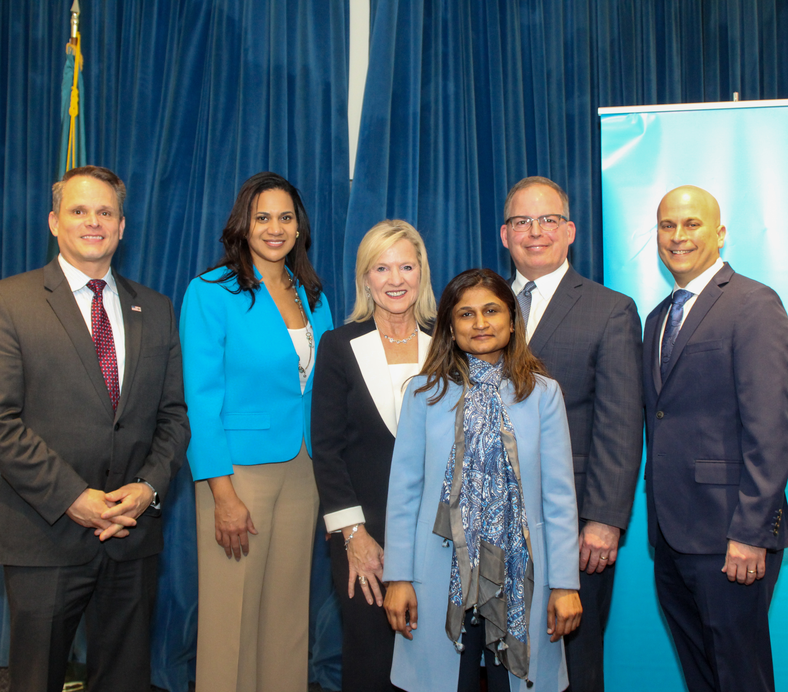
Dedicated Cycle
Announced May 2019
Approved December 2019
Press event January 2020
18 applications, $2.5M
8 approvals, $1.1M

Slide 3
Recipient Orgs & Programs
Organization | Project/Program
Sussex County Health Coalition | Drug Free Sussex County: Expansion of Sussex Goes Purple
Friendship House | Transitional Housing Capacity Building
Triad | New clinical addictions counselor
Jewish Family Services | Supporting the Family: JFS’ Response to the Opioid Crisis
Attack Addiction | Naloxone Distribution and Sussex County Recovery Housing 2019
Boys and Girls Club | Triple Play
NCALL | Beating the Odds in Dover
Bellevue Cause Community Network | Youth Video Production and Destigmatization

Slide 4
Quick Highlights
1 men’s recovery house in Milford, attack addiction
Over 900 youth served, B&GC
Over 210 youth engaged, Bellevue
39 residents reached 90 days of sobriety and gainful employment, Friendship house
68 families served, JFS
1 opioid outreach specialist hired to serve Kent County, NCALL
495 organizations and 5,500 individuals engaged, SCHC
1 clinical therapist hired, TRIAD

Slide 5
2021
Limen House: Mental Health Counseling Financial Assistance
IMPACT Life: Clubhouse Recovery Model
SCHC: Drug Free Sussex County
Various small grants for programs that include some level of SUD/OUD prevention and support
Over $421,000 committed

